Slide 1
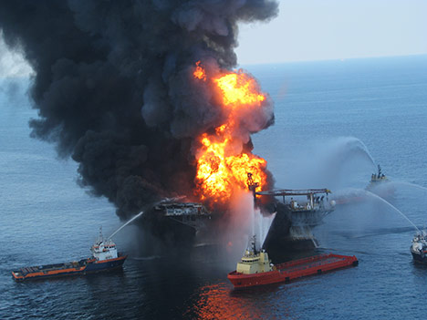
Gulf fisheries are resilient to shocks
Deepwater Horizon Oil Spill
Deviation in Commercial Revenue from Projection:
$1.33 billion

Slide 2



How would you describe the relative differences in marshes and mangroves for each of the following:
 | Marshes are Much Better | Marshes are Slightly Better | No Difference | Mangroves are Slightly Better | Mangroves are Much Better | I don’t know
Supporting coastal fisheries | ☐ | ☐ | ☐ | ☐ | ☐ | ☐
Introduction
Chapter 1
Chapter 2
Chapter 4
Conclusion
Acknowledgments

Slide 3
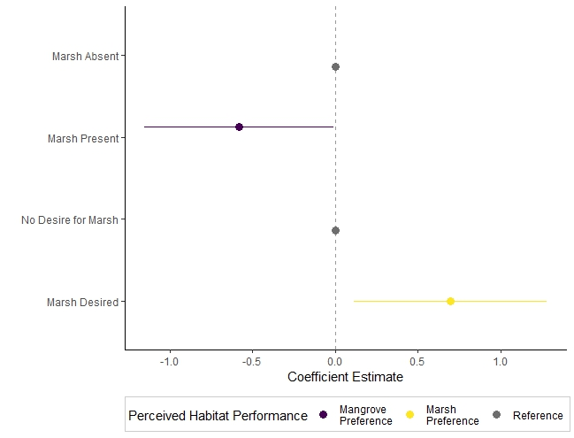

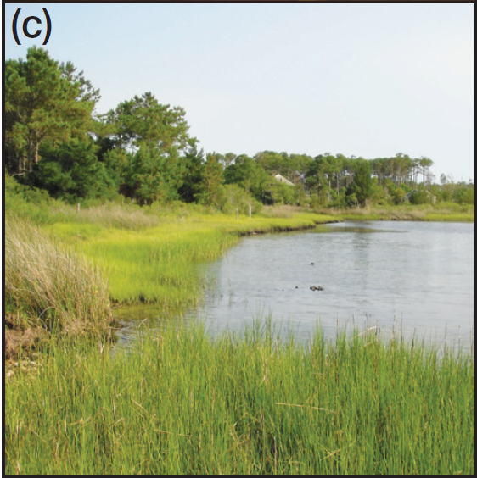
=
Waterfront residents with marsh on their shoreline preferred mangroves for supporting coastal fisheries
Introduction
Chapter 1
Chapter 2
Chapter 4
Conclusion
Acknowledgments

Slide 4

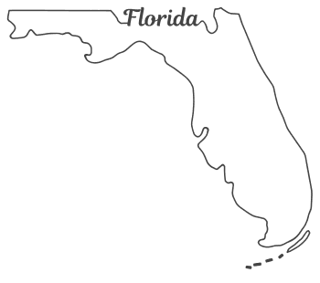


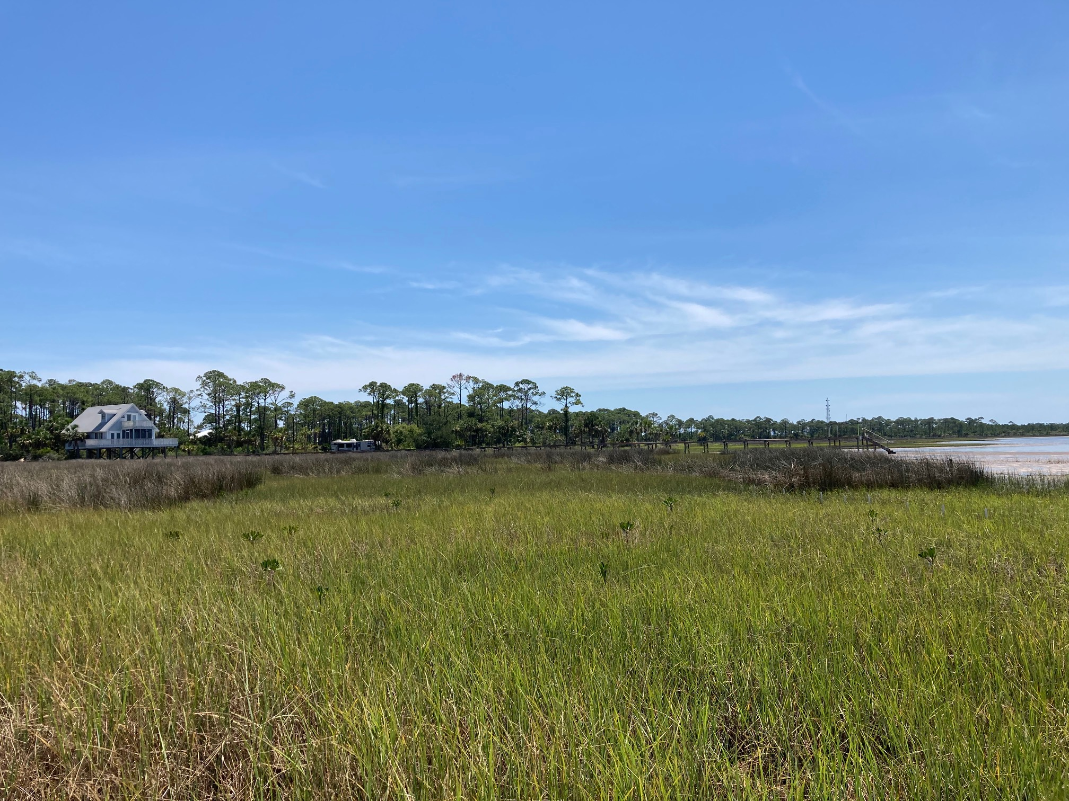

What do people think is better for fish:
salt marshes or mangroves?

